Slide 1

Heterogeneity in mark-recapture models

Slide 2
Accounting for individual heterogeneity in mark-recapture models
  Standard mark-recapture models assume parameter homogeneity
  From a statistical point of view, heterogeneity can induce bias in parameter estimates
  From a biological point of view, heterogeneity is of interest – individual quality

Slide 3
Accounting for individual heterogeneity in mark-recapture models
  If the variability is observed and measured in some way, use this information
    individual covariates
    group effects, …
  If not, use mixture models (also if potential unexplained variability): this lecture

Slide 4
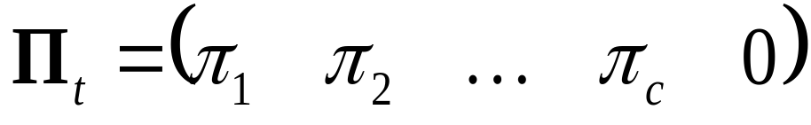
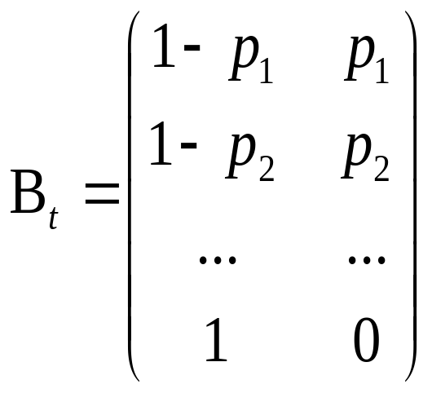
Rewriting Pledger et al. (2003) model for heterogeneity
class :
1 2 … C †
not
encountered
events:
encountered

Slide 5
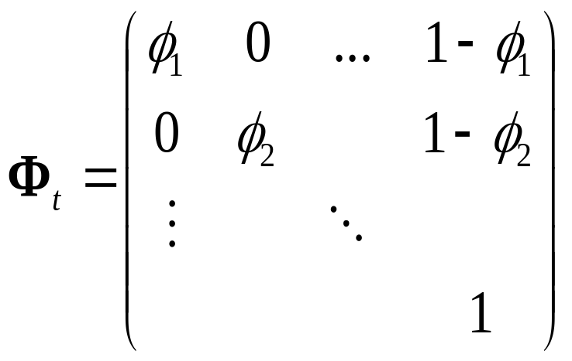
Rewriting Pledger et al. (2003) model for heterogeneity
states:
Alive in class 1 2 … †

Slide 6
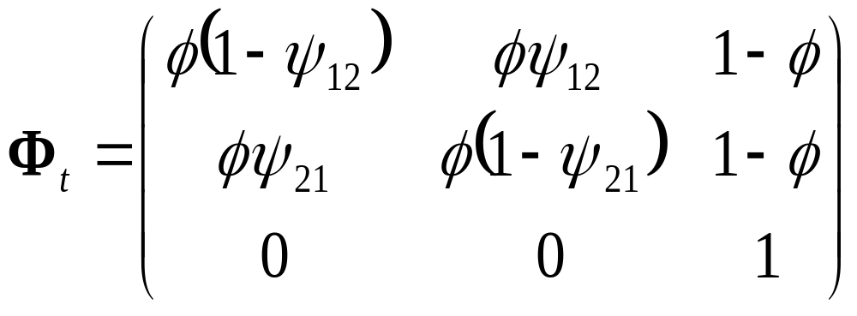
Allowing movements among classes (2 classes here)
states, events, Π and B are unchanged
two new parameters : ψ₁₂ and ψ₂₁, transitions among classes

Slide 7
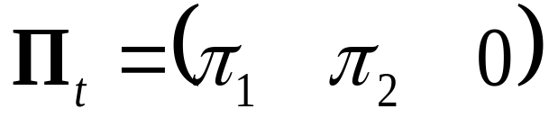
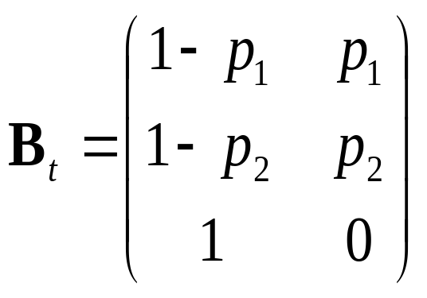
Rewriting Pledger et al. (2003) model for heterogeneity
class :
1 2 †
events:
not
encountered
encountered

Slide 8
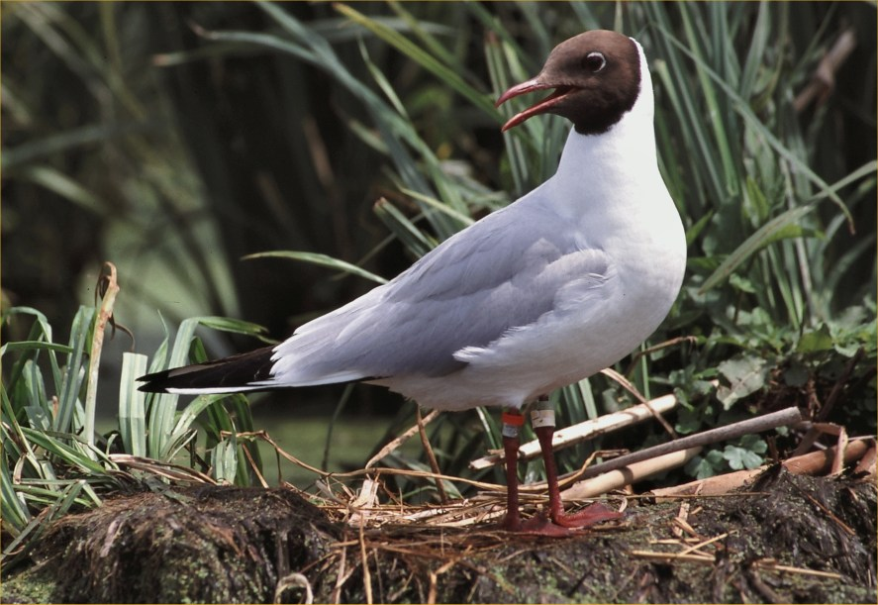
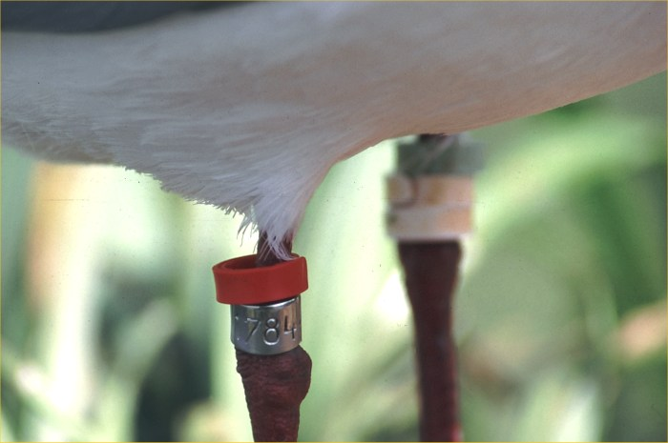
Example of zones of unequal accessibility
Resightings of Black-headed Gulls Chroicocephalus ridibundus,
La Ronze pond, France

Slide 9
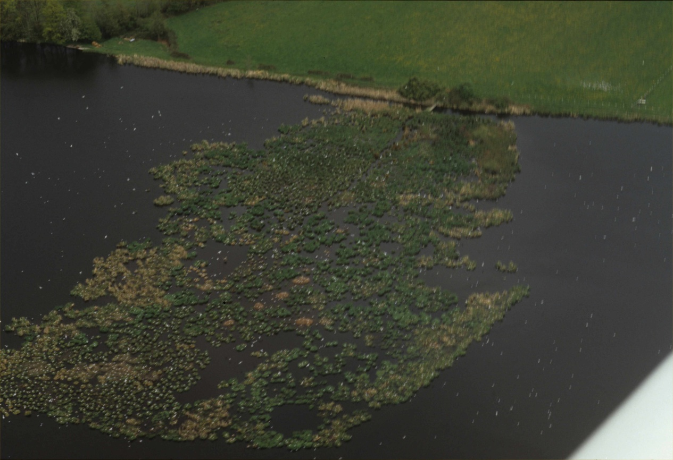
Example of zones of unequal accessibility
Resightings of Black-headed Gulls Chroicocephalus ridibundus,
La Ronze pond, France
The detection strongly depends on the bird’s position

Slide 10
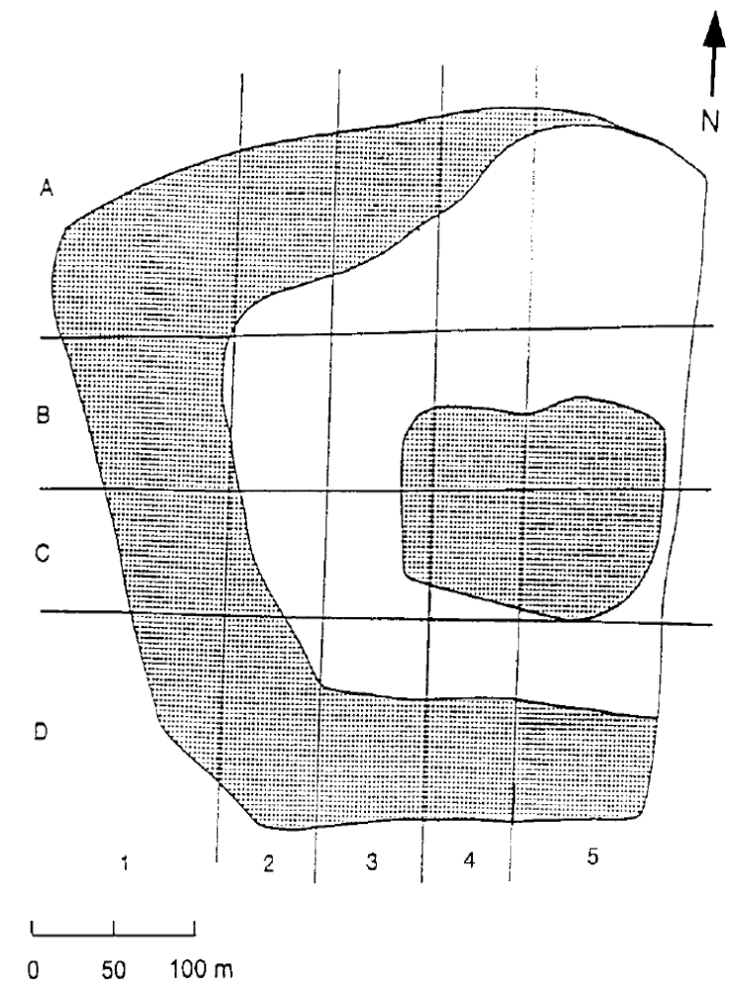
La Ronze pond, central France
zone 1: nests inside the vegetation
zone 2: nests on the edge of vegetation clusters
due to high fidelity, movements between zones should be relatively rare

Slide 11
Example: results
(see also practicals)
Estimated survival : φ= 0.827 (0.018)
zone 1
(inside vegetation?)
Estimates:
p₁= 0.089 (0.018)
π₁= 0.948 (0.056)
zone 2
(vegetation edge?)
Estimates:
p₂= 0.481 (0.099)
π₂= 0.052
ψ₁₂= 0.022 (0.012)
ψ₂₁= 0.094 (0.108)

Slide 12
What are the effects of ignoring heterogeneity?
On population size estimates?
On survival estimates?
On inference about the relationship between
survival and some covariates

Slide 13
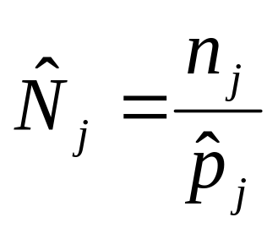
Estimating population size in open population
Standard models provide estimates
of survival & detection probabilities
An estimate of abundance N_{j} at occasion j
is obtained as the number of detected individuals
divided by the estimated detection probability
(Horvitz-Thompson)
# individuals caught at occasion j
Estimated detection probability at occasion j

Slide 14
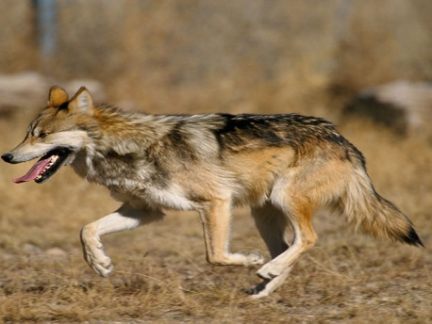
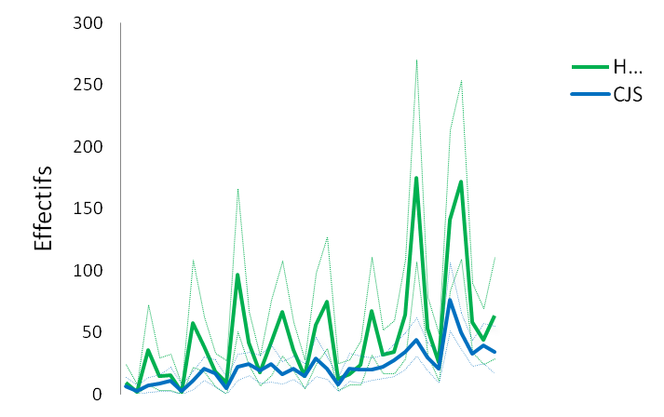
Impact of ignoring heterogeneity in detection – wolfs in French Alps
Homogeneity vs. heterogeneity in detection
Population size
64 [29 ; 111]
33 [17 ; 54]
Time (years)
Strong bias in population size estimates
Cubaynes et al. 2010 in Cons. Biol.

Slide 15
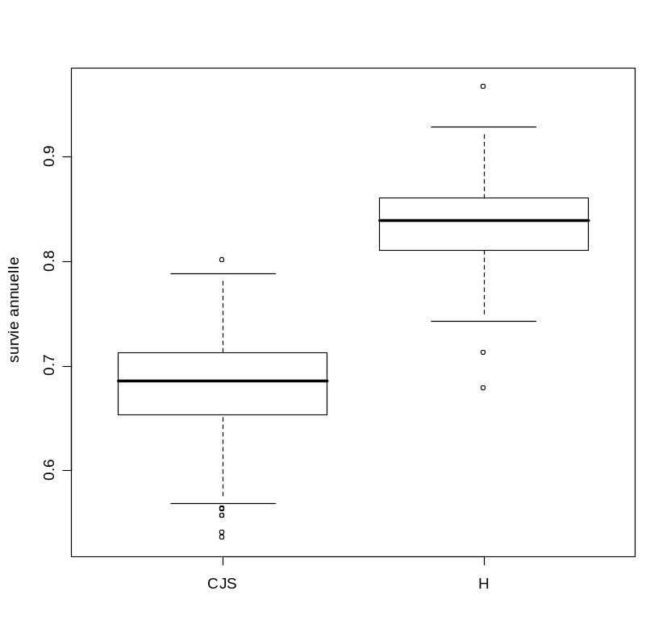
Impact of ignoring heterogeneity in detection – wolfs in French Alps
0.83 (0.06)
0.68 (0.08)
Survival probability
Homogeneity vs. heterogeneity in detection
Bias in survival estimates
Cubaynes et al. 2010 in Cons. Biol.

Slide 16
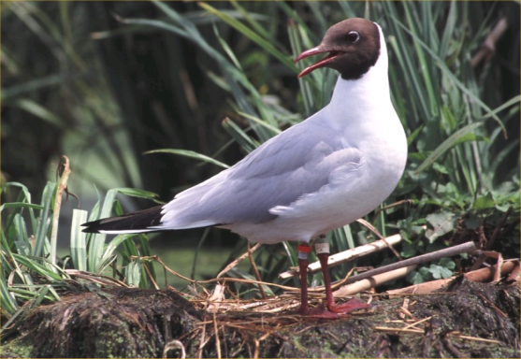
Dealing with heterogeneity in survival – senescence
« Over time, the observed hazard rate will
approach the hazard rate of the
more robust subcohort »
Vaupel & Yashin (1985, Amer.Statistician)
See Péron et al. (2010, Oïkos) for a case study on Black-headed gulls
Using simulations here (see also practicals)

Slide 17
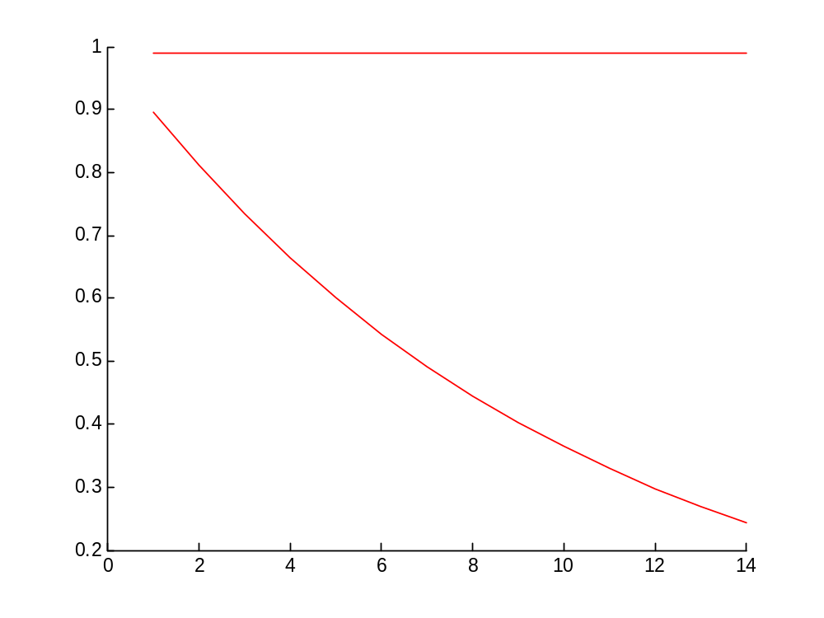
sub-cohort 1
constant survival
Survival
sub-cohort 2
senescence
Age

Slide 18
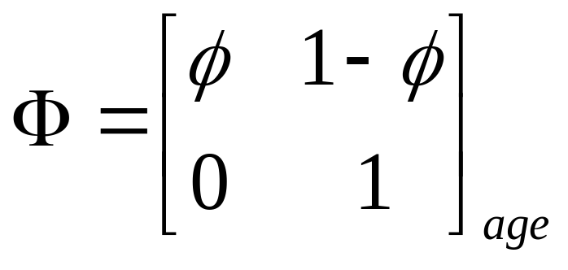
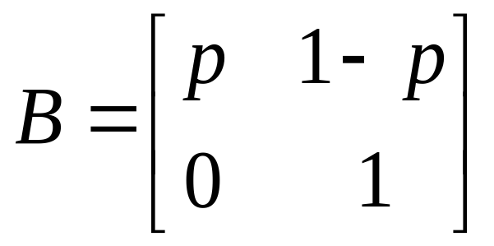
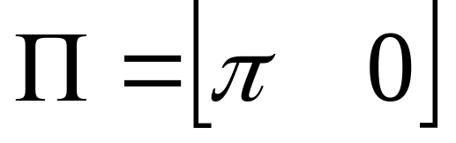
Naïve model
alive
dead
not
encountered
encountered

Slide 19
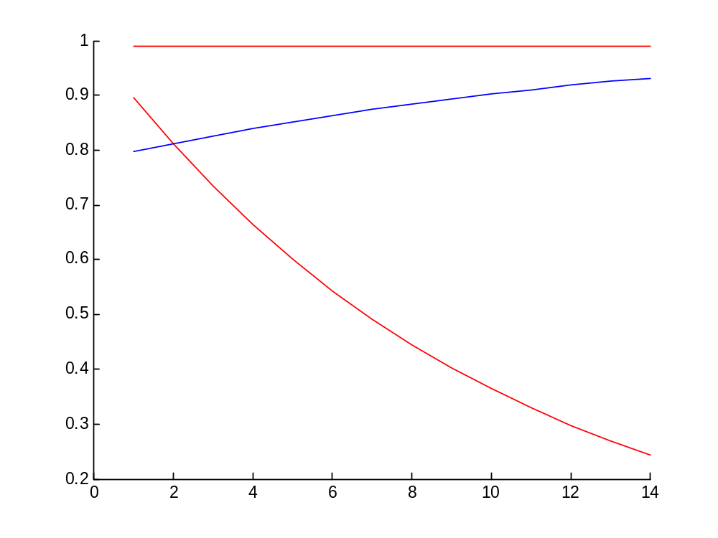
sub-cohort 1
constant survival
« population » - level fit
Survival
sub-cohort 2
senescence
Age

Slide 20
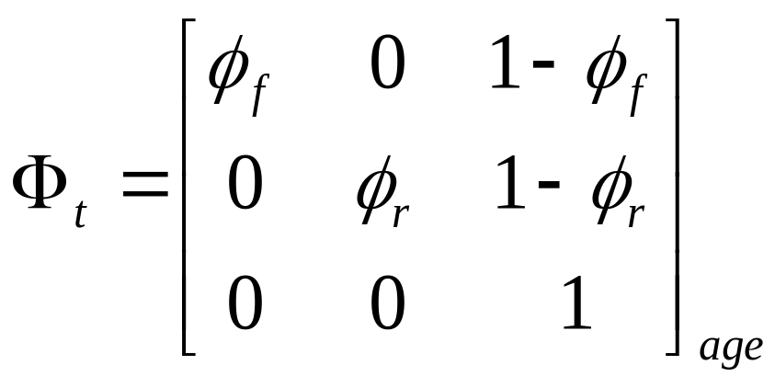
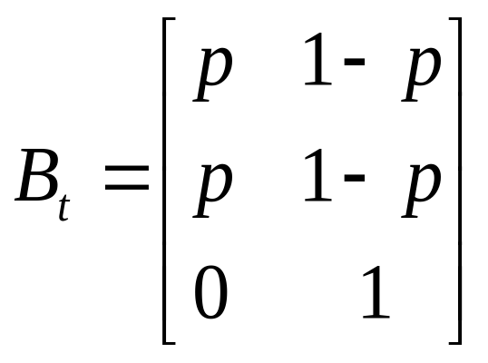

A model with 2 classes of individuals on survival
fragile
robust
dead

Slide 21
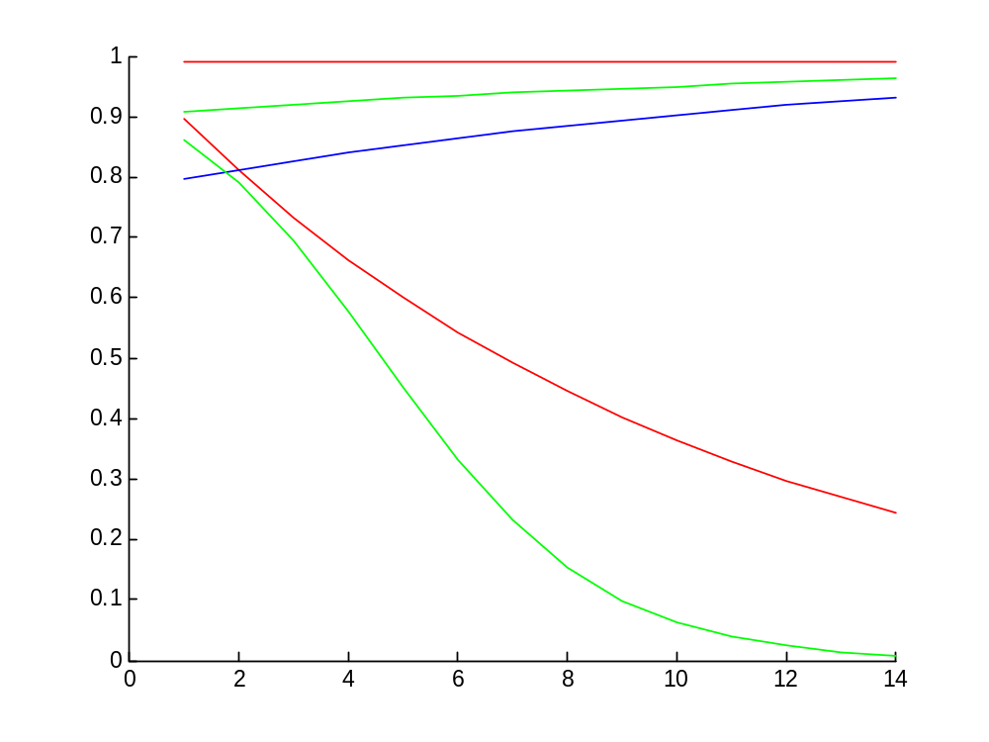
sub-cohort 1
constant survival
« population » - level fit
Survival
sub-cohort 2
senescence
« individual » - level fit
2-class survival
Age

Slide 22
Continuous mixture of individuals
What if I have a continuous mixture of individuals?
Use individual random-effect models
CR mixed models (Royle 2008 Biometrics; Gimenez & Choquet 2010 Ecology)
Notes:
So far, we’ve been considering models with discrete classes of IH.
What if we have a continuous mixture of individuals, rather than 2 values or survival,
a whole range of individual survival probabilities?
You already know the answer, no suspense, we will use an individual random effect
to deal with IH in that situation.
So-called CR mixed models were recently developed by Andy Royle and our team.

Slide 23

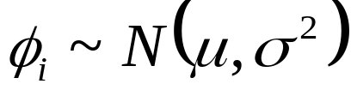

Individual random-effect models
Explain individual variation in survival
No variation – homogeneity
Individual random effect – in-between
Saturated – full heterogeneity
Notes:
In the middle, we assume that these survival prob are drawn from a population of survival
in a normal distribution (on some appropriate scale).
Rather than having as many parameters as individuals, there are only two.
A mean survival, and a variance term that captures the inter-individual differences.

Slide 24
Continuous mixture of individuals
What if I have a continuous mixture of individuals?
Use individual random-effect models (Royle 2008 Biometrics, Gimenez & Choquet 2010 Ecology)
Mimic examples in Vaupel and Yashin (1985) with p < 1 using simulated data
In GEMACO, ‘i + ind’ does the job
Notes:
Again to fix ideas, let us simulated data.

Slide 25
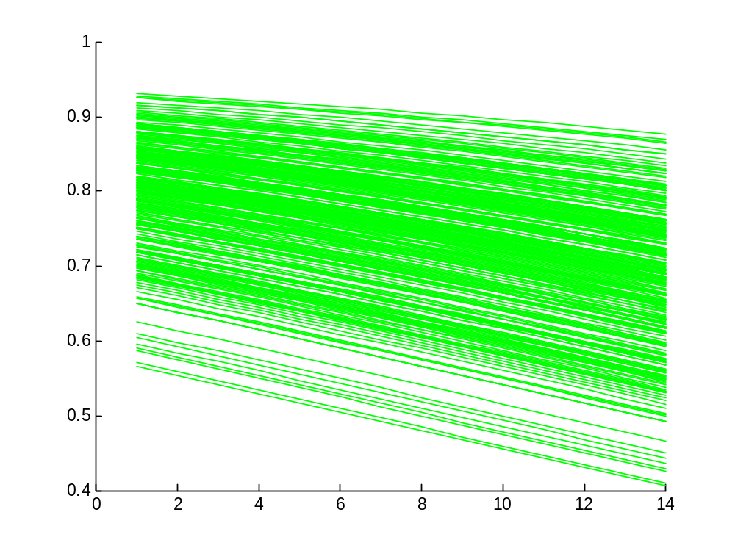
Survival
300 individuals
logit(φ_{i}(a)) = 1.5 - 0.05 a + u_{i}
u_{i} ~ N(0,σ=0.5)
Age
Notes:
Survival as a fn of age, each green line being the trajectory of an individual.
These trajectories are generated according to a decreasing fn of age, with some IH

Slide 26
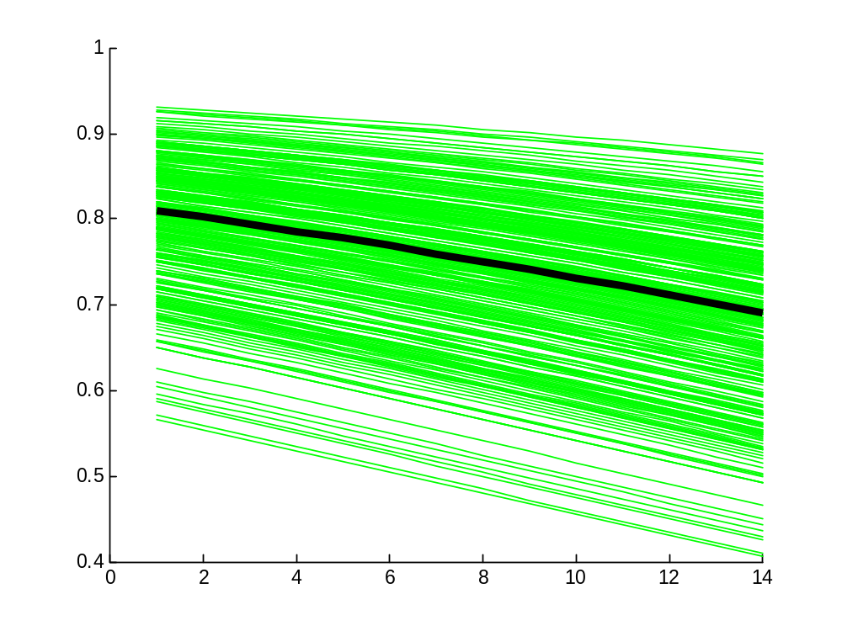
Survival
Expected pattern
E(logit(φ_{i}(a))) = 1.5 - 0.05 a
Age
Notes:
In black here, this is the expected pattern, individuals age on average according to this black line

Slide 27

Survival
Fit at the population level
Age
Notes:
However, if we fit a model without IH, in which survival is a fn of age, then we get
the red line, something flat and slightly increasing, the response at the population
level being driven by individuals with high survival.

Slide 28
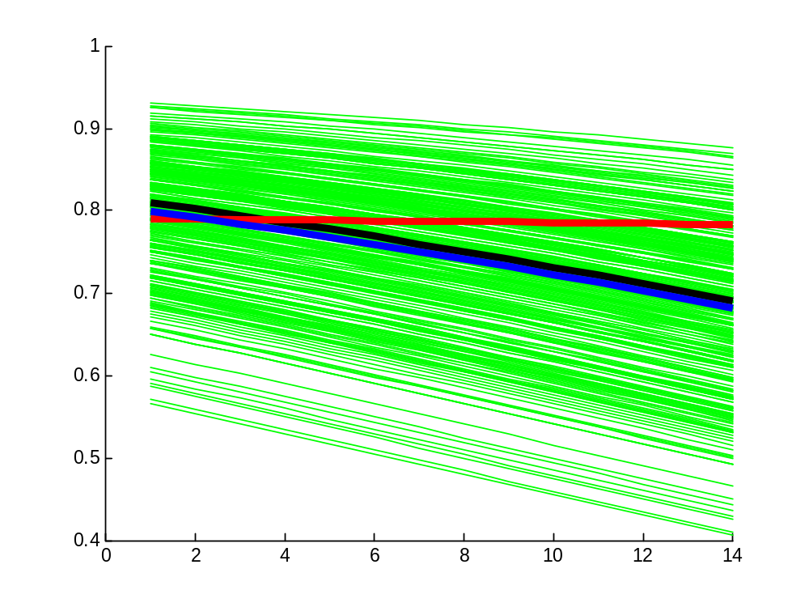
Survival
Fit at the individual level
with an individual random effect
Age
Notes:
Now if you fit the same model with an individual random effect to catch IH,
then we get the correct pattern, the blue line, the one you used to simulated data.

Slide 29
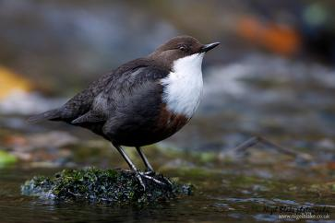
Senescence in European dippers
Notes:
To illustrate the importance of accounting for IH using random effect, we studied
senescence in the famous European dippers, with G. Marzolin the guy who originally
shared his data with Jean-Do for the 1992 monograph. This is also a dataset that is used
In the gentle introduction to Mark.
In passing, this success story of data sharing is something to think about for the round table,
given the influence this dataset had on the development of CR models…

Slide 30
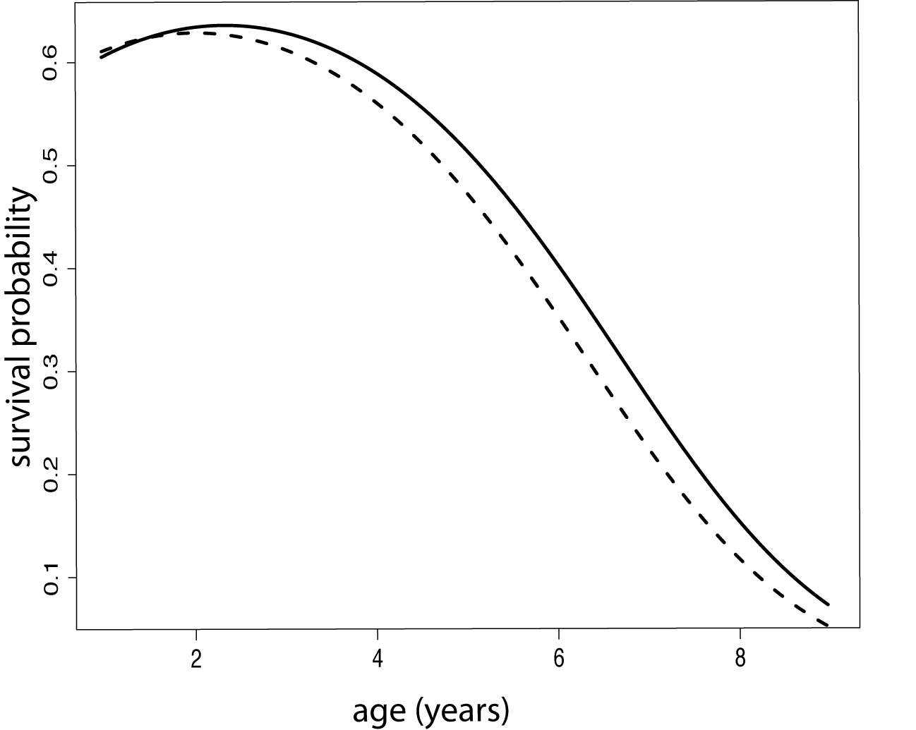
Senescence in European dippers
with IH: onset = 1.94
Marzolin et al. (2011) Ecology
Notes:
Gilbert was interested in senescence in this short-lived bird.
He found that IH was important to consider, that there was senescence,
and that dippers started being affected by senescence from 2 years of age on average.

Slide 31
Senescence in European dippers
without IH: onset = 2.28
with IH: onset = 1.94
Marzolin et al. (2011) Ecology
Notes:
Interestingly, if we ignored IH, then the onset of senescence was overestimated,
which would have important consequences if we were to do some evolutionary scenarios.

Slide 32
Conclusions
Ignoring heterogeneity in detection or survival can cause bias in parameter estimation (survival, abundance)
Ignoring heterogeneity in detection or survival can cause bias in biological inference
Heterogeneity in itself is fascinating
Multievent models provide a flexible framework to incorporate heterogeneity in mark-recapture models

Slide 33
Conclusions
Caution: big issues of parameter redundancy and local minima
Mixture models: choice of the number of classes based on prior biological assumptions – model selection using AIC (Cubaynes et al. 2012 MEE)
Random-effect models: significance via LRT (halve the p-value of the standard test; Gimenez & Choquet 2010 Ecology)

